Slide 1
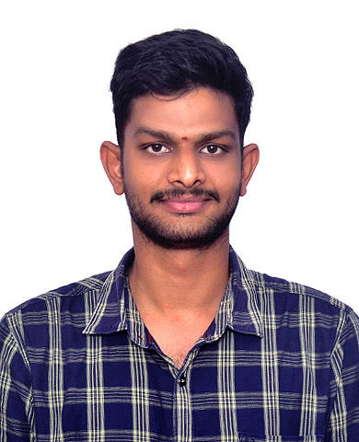
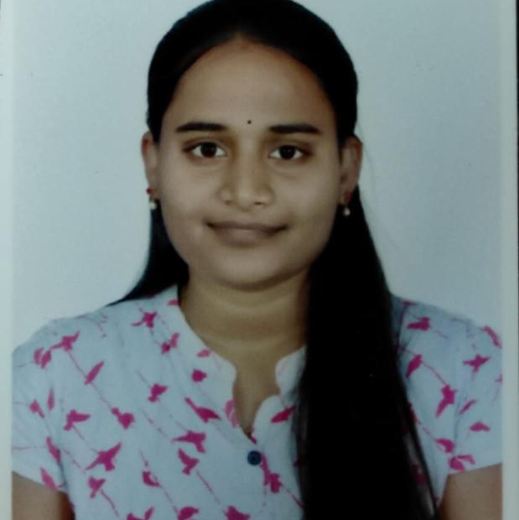
K.G.S.SURYA VARMA
Bachelor of Technology,
Electronics and Communication Engineering:2015-19
Analyst/Software Engineer
SKILLS
Bangalore
Java 8 / J2EE | Java Basics, OOPS, Generics, Collections, Arrays, Loops, Lambda Exp, stream API, Junit, Servlets
Spring | Auto-wire, IOC Dependency Injection
Frameworks | Hibernate & Spring
Database | PostgreSQL, MongoDB
Tools | Git, Postman, Swagger, Eclipse IDE, Visual Studio Code
Spring Data JPA | Implement DAO Layer using Spring data repository.
Angular | Components, Services, Modules, Routing, Forms & Validations.
UI Tech | HTML, Java script, Typescript , CSS Bootstrap.
Spring Cloud | Eureka
Add On skills | Peer learning, Communication.
kalidindi.Ganeswara-sai-surya-varma@capgemini.com
+919492026992
A4
Full Stack Developer trained on JEE full stack with Angular
Hands on experience on
Core Java
J2EE
Spring Boot Micro-Services
PostgreSQL, MongoDB
Hibernate and Spring Frameworks
HTML, CSS , JavaScript , Typescript and Angular
Git and GitHub
FINAL CASE STUDY:
Created an AUTOMATION TRAVEL AGENCY With PostgreSQL as Backend and Java and Spring Boot as middleware and Angular as frontend. Used HTML, CSS ,Bootstrap and TypeScript for the UI designing.
Created an PHARMACY-MANAGEMENT With MongoDB as Backend and Java and Spring Boot Micro-Services as middleware and Angular as frontend. Used HTML, CSS ,Bootstrap and TypeScript for the UI designing.

